Slide 1
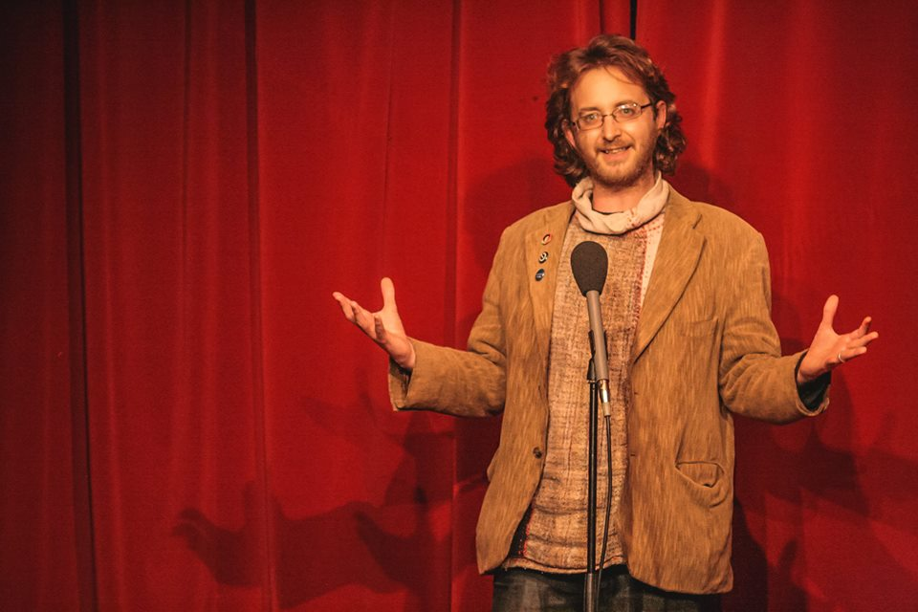
The Possibilities of Podcasting
Getting Better Acquainted, The Family Tree, Spark, Stand Up Tragedy, The Restart Project
www.davepickeringstoryteller.co.uk

Slide 2
What makes a podcast different from traditional radio?
No gatekeepers
No rules
On demand
Direct relationship between audience and creator
The Internet/Smart Phones
Intimacy
Immediacy
All the time you need
“Easy” for anyone to make
No Set Duration
Interactive communities

Slide 3
No Rules means you have to make your own
You are your first audience member so make sure you are making what you want to hear
It takes time to be as good as what you like
“The Work” has to happen at some point
Citizen Kane
We’ve only scratched the surface of the medium

Slide 4
Moving out of the studio (both literally and metaphorically)
Set and Setting
Personal Spaces
Less People Who Look Like Me
Capturing the unexpected and the unknown
“Live” moments

Slide 5
Messy Sound
Life is messy
Stravinsky’s Rite Of Spring
“We talk on phones all the time”
Relearning to listen

Slide 6
The danger of aspiring to be a professional
Learning in public
Asking
Personal relationships
Making podcasts is so boring so why not make them about something you love?
It’s hard to make bad content good.
It’s easier to make bad recordings of good content into a great audio than to make a brilliant recording of uninteresting content into great audio.

Slide 7
Getting Specific
The more specific it is the more universal it becomes
Character
Passion
Unheard voices
Unheard subjects

Slide 8
Binaural Microphones and Tinny Headphones
Brilliant production and clear audio can also be great
Make your limitations into strengths
We need to consider what people use to listen as well as what we use to record
Competing sounds
There is room for all kinds of audio in podcasting

Slide 9
What is out there? some examples
Beautiful Stories from Anonymous People
The Message
Bright Sessions
Another Round
The Guilty Feminist
How To Be A Girl
My Dad Wrote A Porno
The Whorecast
One Bad Mother
Hardcore History
Mental Illness Happy Hour
Love + Radio
Risk! Radiolab
Eardrop
Radio Atlas
Hackney Hear / Soho Stories

Slide 10
What is out there? some genres
Documentary
Interviews/Conversations
Sitcom
Drama
Fiction
Magazine
Panel Shows
Lectures/Education
True Stories
True Crime
Oral History
Live Performance
Spoken Word
Music
Improvisation

Slide 11
What could be out there?

